Slide 1


System Analysis And Design (SAD)
Smita Bisht
Assistant Professor
School of Polytechnic

Slide 2
WHAT IS SOFTWARE PROTOTYPE?
Prototyping is defined as the process of developing a working replication of a product or system that has to be engineered.
The Software Prototyping refers to building software application prototypes which displays the functionality of the product under development.
It helps get valuable feedback from the customer and helps software designers and developers understand about what exactly is expected from the product under development.

Slide 3
WATERFALL MODEL
The Waterfall Model was the first Process Model to be introduced. It is also referred to as a linear-sequential life cycle model. .
This model is named “waterfall model” because its diagrammatic representation resembles a cascade of waterfalls.
All the phases of SDLC will function one after another in linear manner. That is, when the first phase is finished then only the second phase will start and so on.

Slide 4
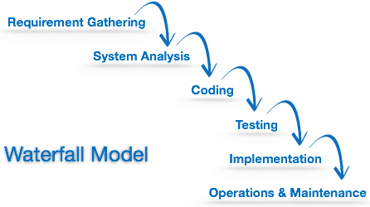

Slide 5
This model assumes that everything is carried out and taken place perfectly as planned in the previous stage and there is no need to think about the past issues that may arise in the next phase
This model does not work smoothly if there are some issues left at the previous step.
It is difficult to define all requirements at the beginning of a project. This model is not suitable for accommodating any change

Slide 6
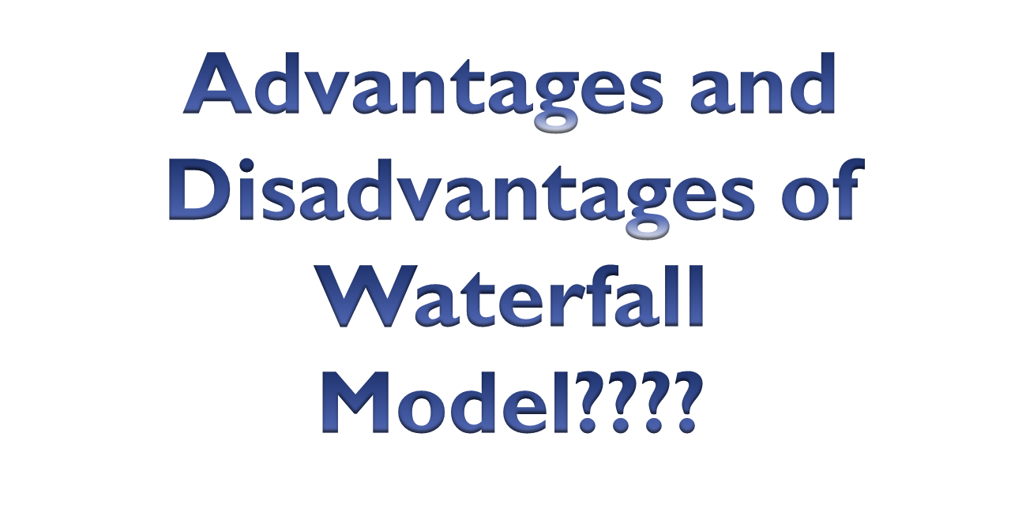

Slide 7
SPIRAL MODEL
The spiral model is similar to the incremental model, with more emphasis placed on risk analysis.
The Spiral Model has four phases:
    Planning.
    Risk Analysis.
    Engineering.
    Evaluation.
    A software project repeatedly passes through these phases in iterations (called Spirals in this model).
.

Slide 8
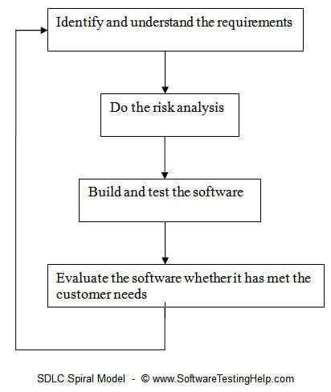
To explain in simpler terms, the steps involved in spiral model are:

Slide 9
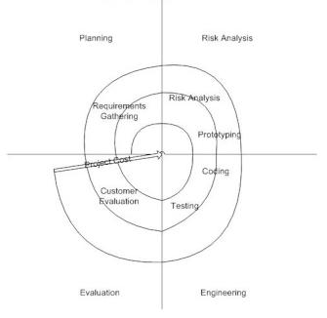

Slide 10
Spiral Model undergoes 4 phases:-
Planning Phase – Requirement Gathering, Cost Estimation, Resource Allocation
Risk Analysis Phase – Strengths and weaknesses of the project.
Design Phase – Coding, Internal Testing and deployment.
Evaluation Phase – Client Evaluation (Client side Testing) to get the feedback

Slide 11
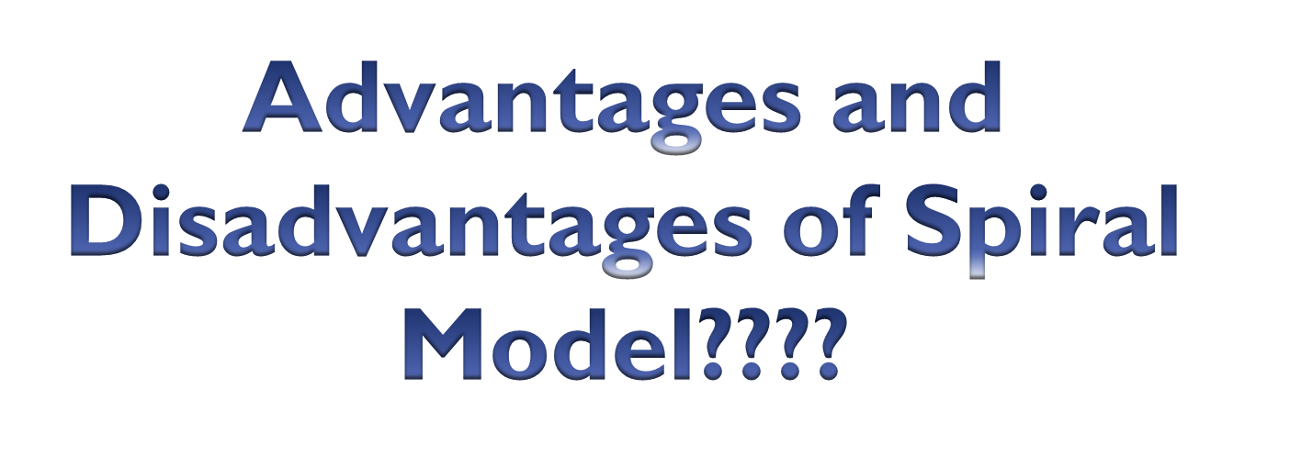

Slide 12
V-MODEL
The V-model is an SDLC model where execution of processes happens in a sequential manner in a V-shape. It is also known as Verification and Validation model.
Development of each step directly associated with the testing phase.
In this each phase of SDLC must be completed before the next phase starts. It follows a sequential design process same like waterfall model.

Slide 13
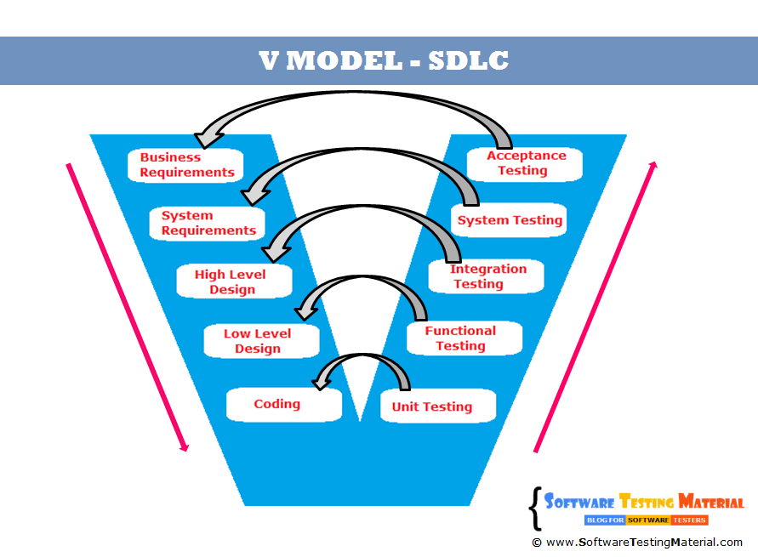
VERIFICATION
VALIDATION

Slide 14
VERIFICATION
Are we building the system right?
Verification is the process of evaluating products of a development phase to find out whether they meet the specified requirements.
The objective of Verification is to make sure that the product being develop is as per the requirements and design specifications.
It is basically manually checking the of documents and files like requirement specifications etc.
Execution of code is not comes under Verification.

Slide 15
VALIDATION
Are we building the right system?
Validation is the process of evaluating software at the end of the development process to determine whether software meets the customer expectations and requirements.
The objective of Validation is to make sure that the product actually meet up the user’s requirements, and check whether the specifications were correct in the first place.
Execution of code is comes under Validation.

Slide 16
Why do we use V-Model, if it is same as Waterfall Model????
It overcomes the disadvantages of waterfall model. In the waterfall model, we have seen that testers involve in the project only at the last phase of the development process.
In this model, testing starts in early stages of product development which avoids downward flow of defects which in turns reduces lot of rework.
Both teams (test and development) work in parallel.

Slide 17
